Slide 1
Phases of Circular Flow of Income

Slide 2
Phases of Circular Flow of Income
The three different phases in a circular flow of income are Generation, Distribution, and Disposition.

Slide 3
1. Generation Phase
The first phase of the circular flow of income is Generation Phase. In this phase, the firms produce goods and services by taking the help of the factor services.

Slide 4
2. Distribution Phase
The second phase of the circular flow of income is the Distribution Phase. In this phase, factor incomes such as wages, rent, interest, and profit flow from firms to the households.

Slide 5
3. Disposition Phase
The last phase of the circular flow of income is the Disposition Phase. In this phase, the income received by the factors of production is spent on the goods and services produced by the firms

Slide 6
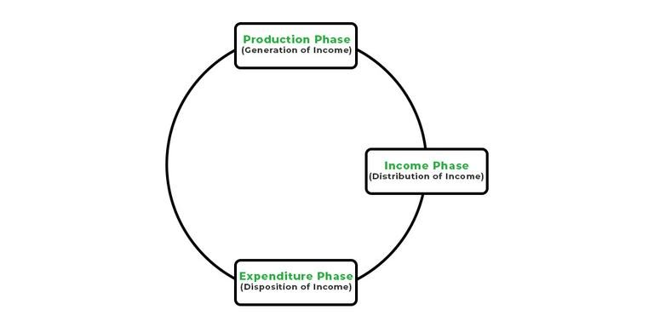
Hence, through the different phases of the circular flow of income, the income generated in production units of an economy reaches back to the production units and completes the circular flow.

